Slide 1
#3 SAD Project Review
R1: Migliorare il profilo Giocatore
Vincenzo Luigi Bruno
Salvatore Cangiano
Cristina Carleo

Slide 2
Searching for a player
01
02
03
04
Search bar
You can search you friend by email
Gui Controller
We created a new endpoint for the user interaface
Controller T23
Endpoint for the retrieve of the UserFollowing profile
User Service
Business logic for information retrieval

Slide 3
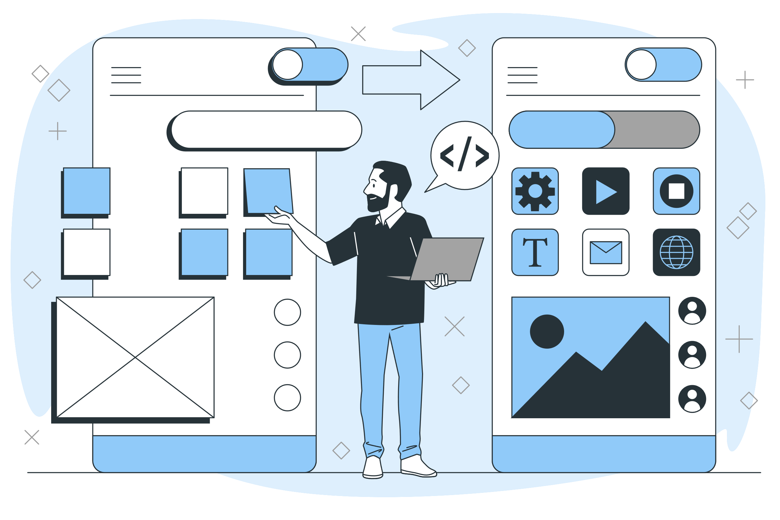
Following a player
01
02
03
04
Follow
You can push the follow button in the Following profile
Gui Controller
New endpoint to update the users’ follower and following
Controller T23
Endpoint to modifify ptofile’s informations
User Service
Updating follower’s following list and following’s follower list

Slide 4
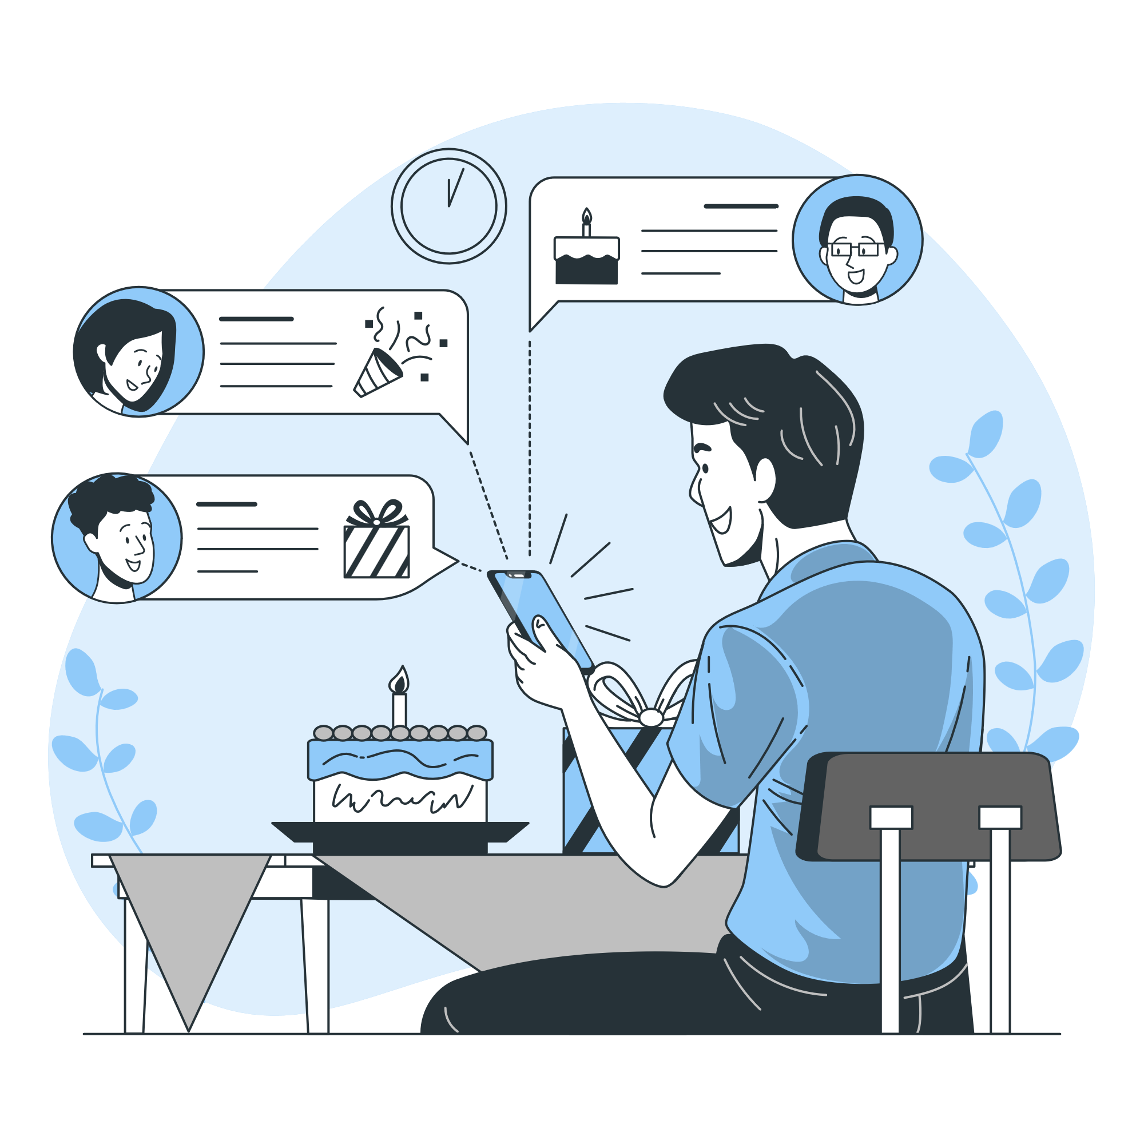
Integration with the notification service
At last, we have integrated the new functionality from this sprint with that from the previous one. As a result, when a new follower is added, the notification service will alert you.

Slide 5
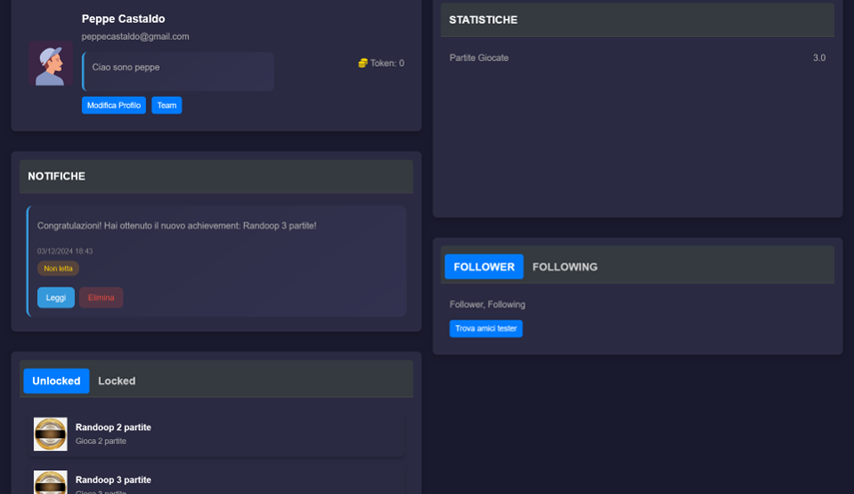
Let’s see the demo
We have implemented a few improvements compared to the mockup:
See who follows who: searchbar for followers and followers on both user and friend profiles

Slide 6
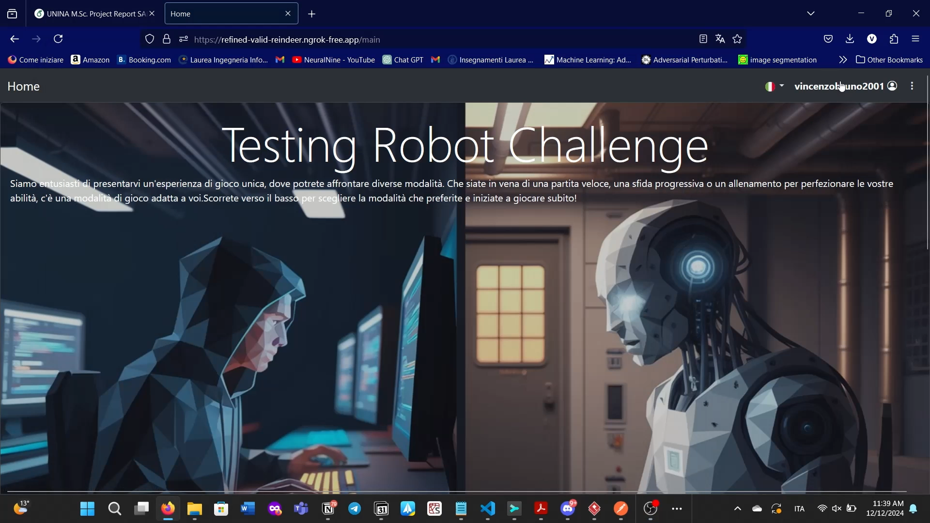

Slide 7
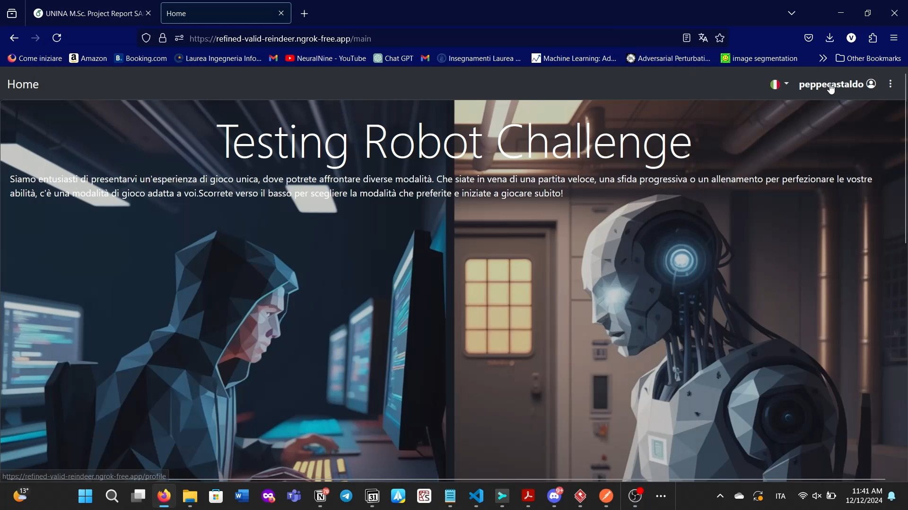

Slide 8
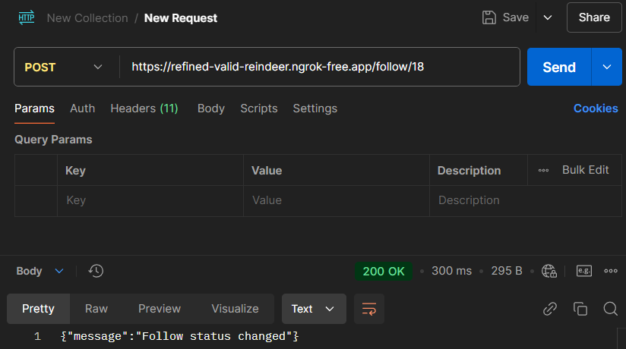

Let's try to convince you that it works
We used Postman to test the new endpoints we created. This are some examples of what you can find in our documentation.
Update-profile
GET Notifications
GET Followers
New-notification
Follow\{playerID}
Update-notifications
DELETE Notification

Slide 9
By our Team
Thank you for your attention
Salvatore Cangiano
Vincenzo Luigi Bruno
Cristina Carleo

